Slide 1

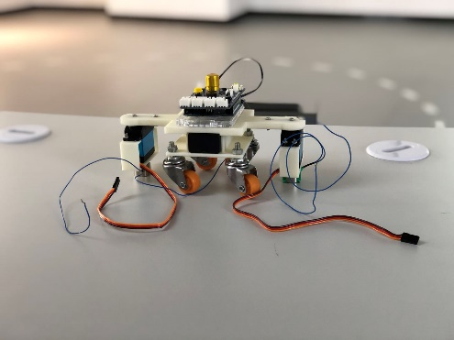
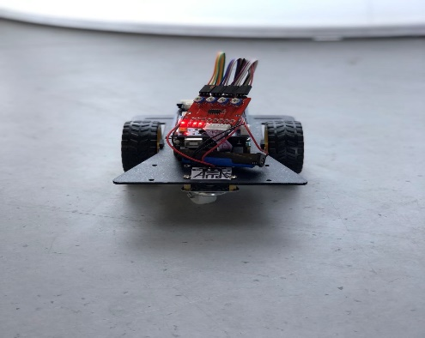
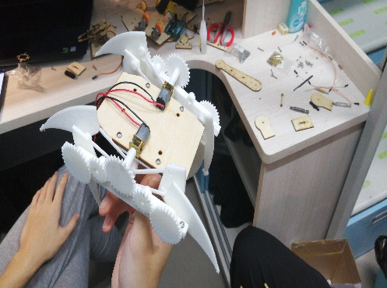
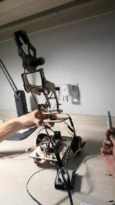
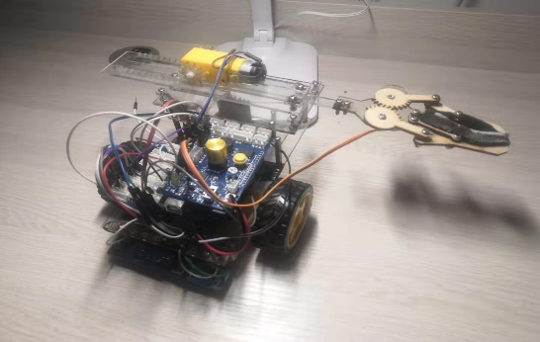
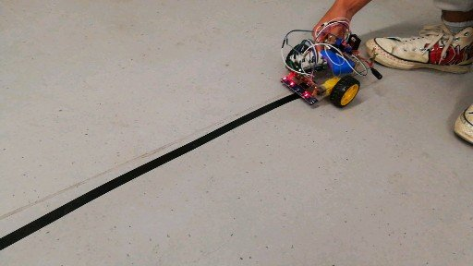
A
Vg 100 Project: To Build a robotic car
T
Treasures Gained From Our Vg Project
Yuchen Liu, Yuchen Song, Luochuan Zhang, Xuewen Wang, Wei Yan -------- Team Atlas
L
A
Speaker: Wei Yan
S

Slide 2

OUTLINE
1. Being Cohesive in the Project
2. Assessing the Principles
3. Evaluating the Performances
4. Reflecting on the Things We have learned

Slide 3
1
Collaboration

Slide 4
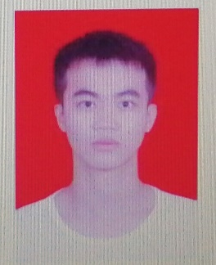
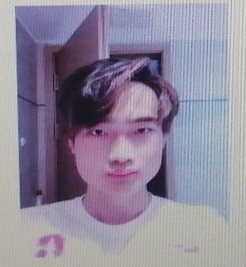
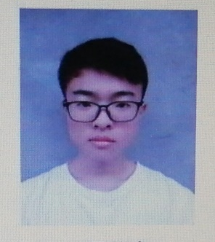
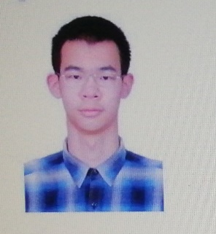
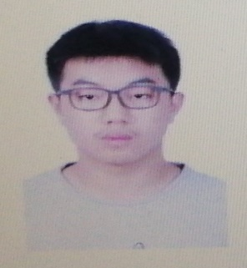
Working Allocation Towards a Common Goal
A Clear Working Structure in the project
Member | Member | Member | Leader | Member
Programming | Programming | Debugging | Assembling | Assembling
Coding Sensors | Coding Servos | Testing | Using SolidWorks | Using SolidWorks
Presenting PPT | Recording videos | Writing Reports | Deciding | Purchasing
Coordinating | Editing videos |  | Assembling | Making Posters
Meeting and discussing | Meeting and discussing | Meeting and discussing | Meeting and discussing | Meeting and discussing

Slide 5
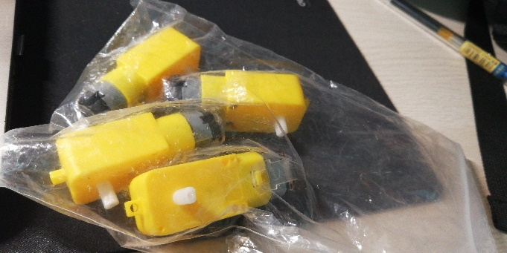
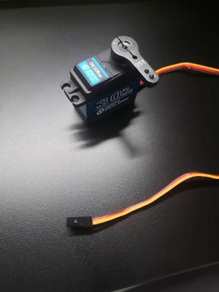
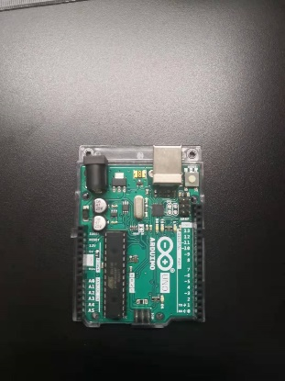
Budget Analysis
Also…
Keep on the good work
From the pie chart, we could see that:
Most of our money was spent on motors and the controlling systems.
This is very regular distribution, which is a good sign.

Slide 6
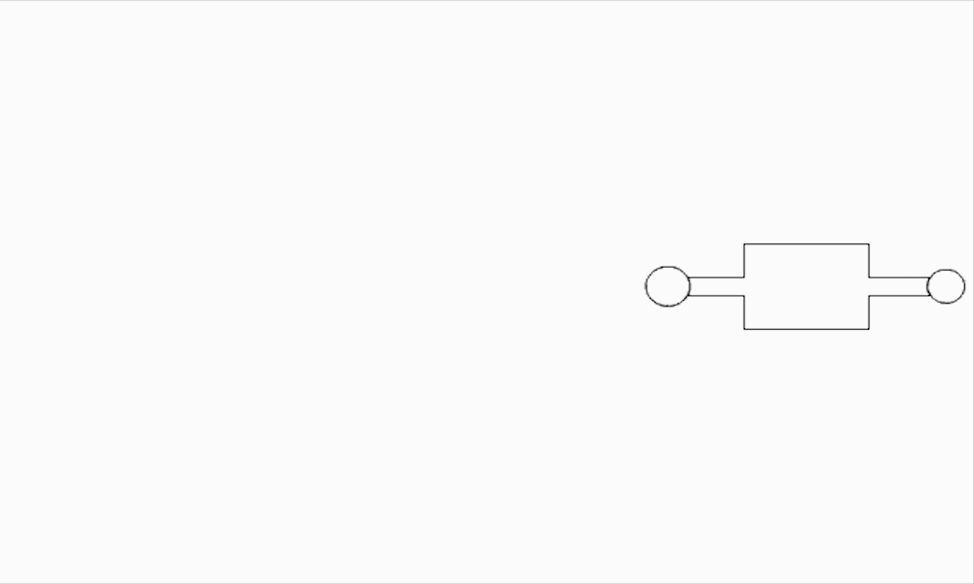
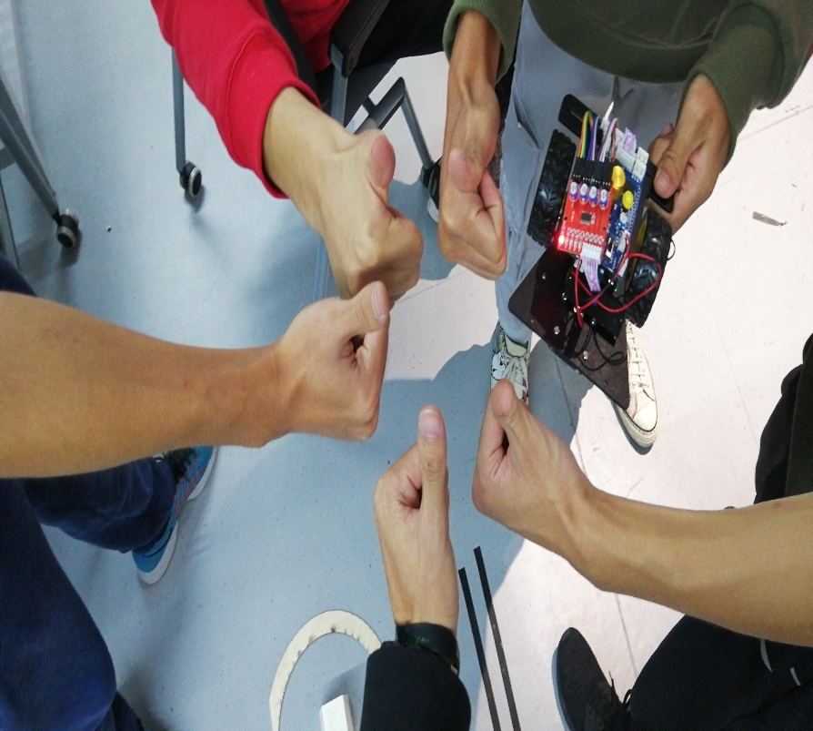
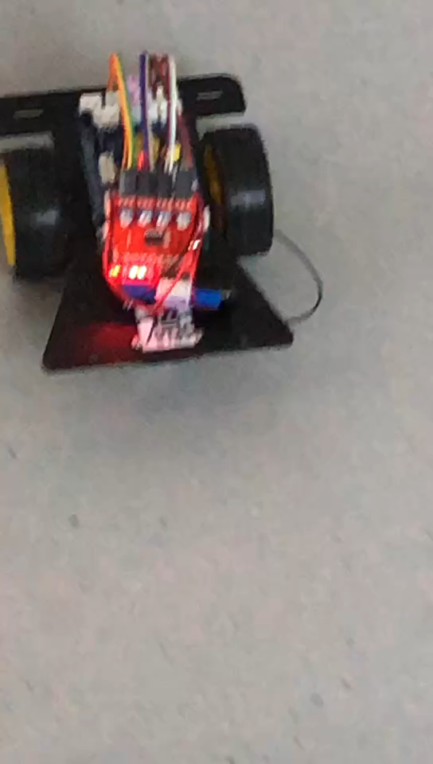
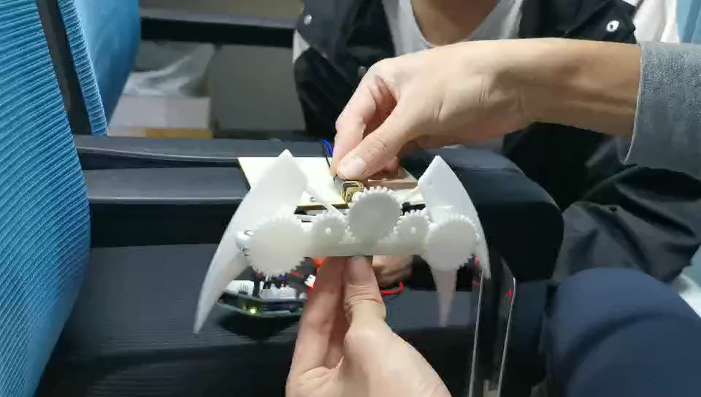
Fighting towards the goal

Slide 7
2
Assessment

Slide 8
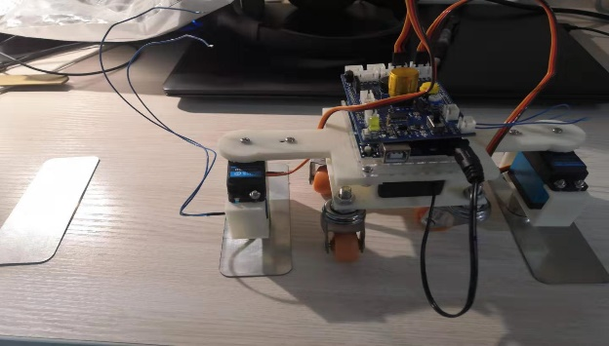

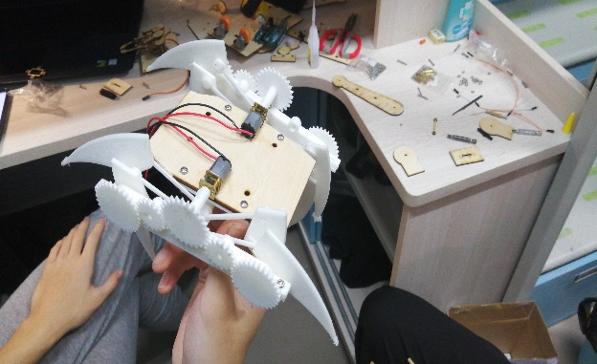
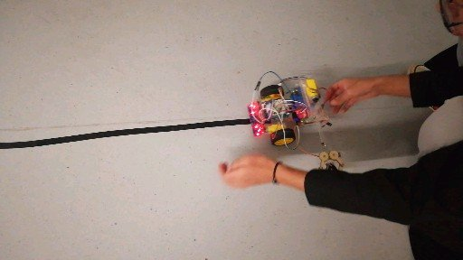
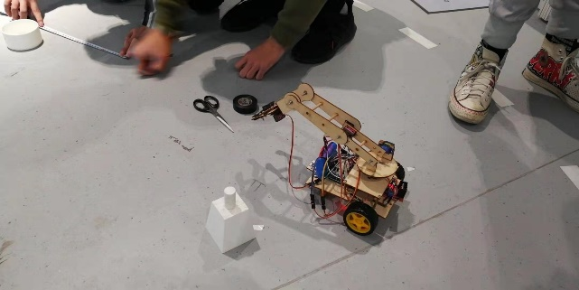
How do they function?
Servo Rotating
What about….?
Legs Crawling
Wheels rolling

Slide 9
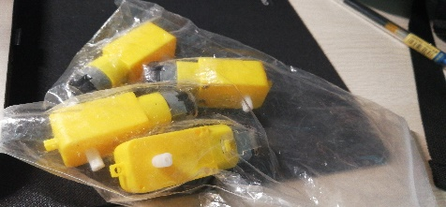
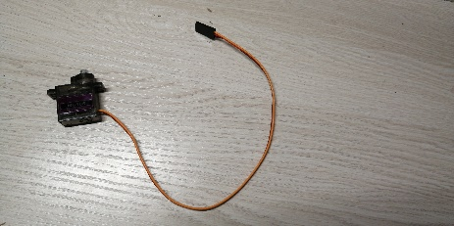
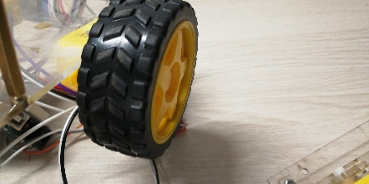
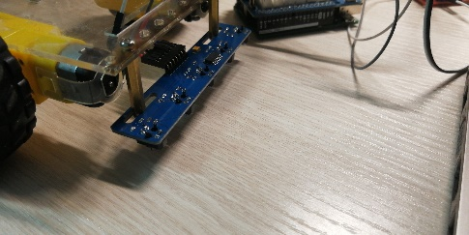

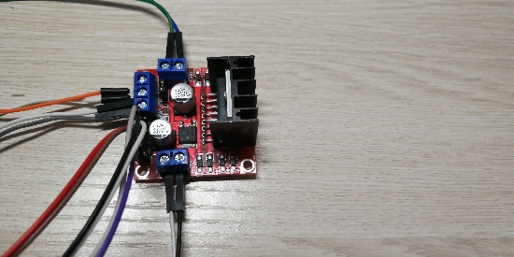
How does it function?

Slide 10
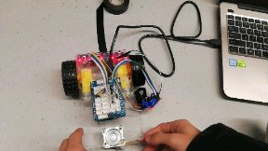

Turning Principles
Sensors detect the tape
Feedback
Motors adjust the speed
Sensors detect the tape
Directions
Keep on the Right Track
Wrong Track
Go
Driving Module adjusts the speed

Slide 11

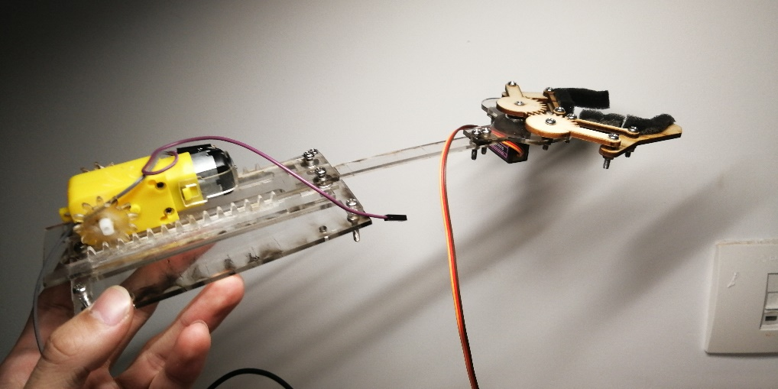
The Grippers
For Gameday Two
Multiple DOF and servo-based
Accurate but Slow
Hard to program the codes
More power to generate
For the expo
Two DOF and gear-based
Accurate and Quick
Easy codes
Saving the energy

Slide 12
3
Performance

Slide 13
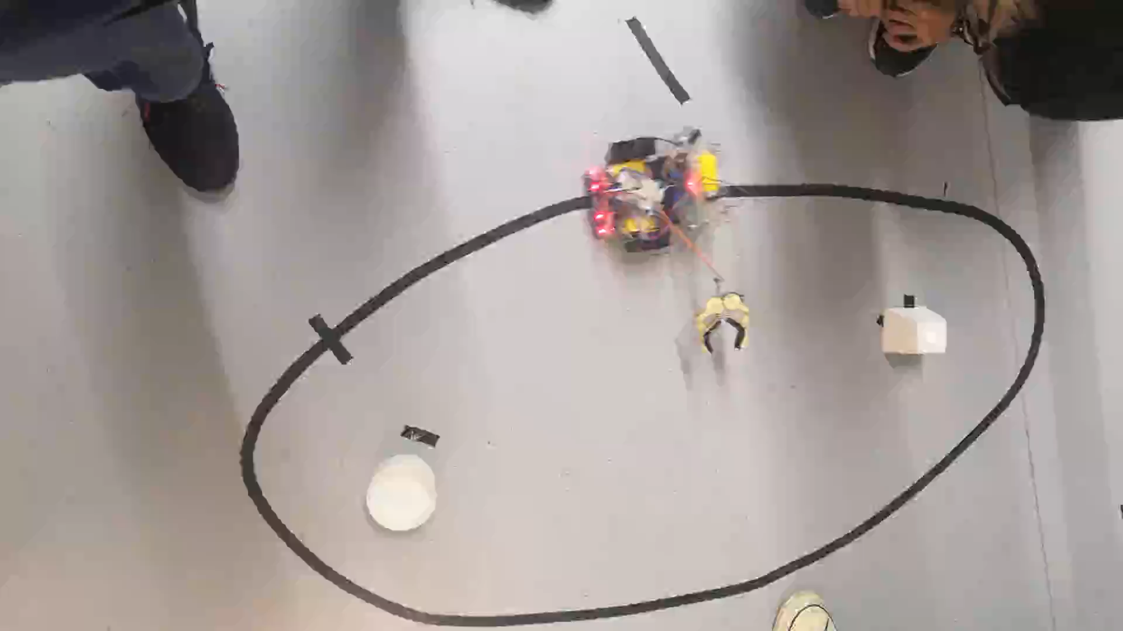
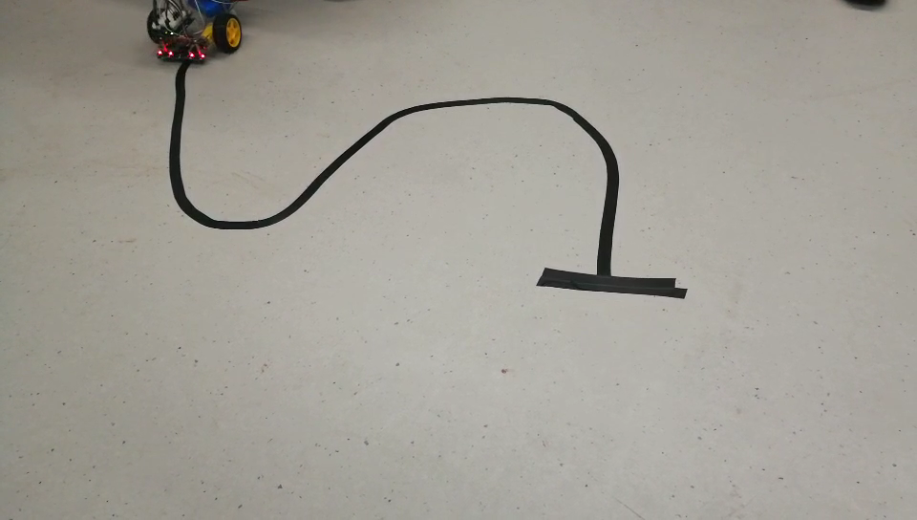
How they turn
Follow the tape

Slide 14
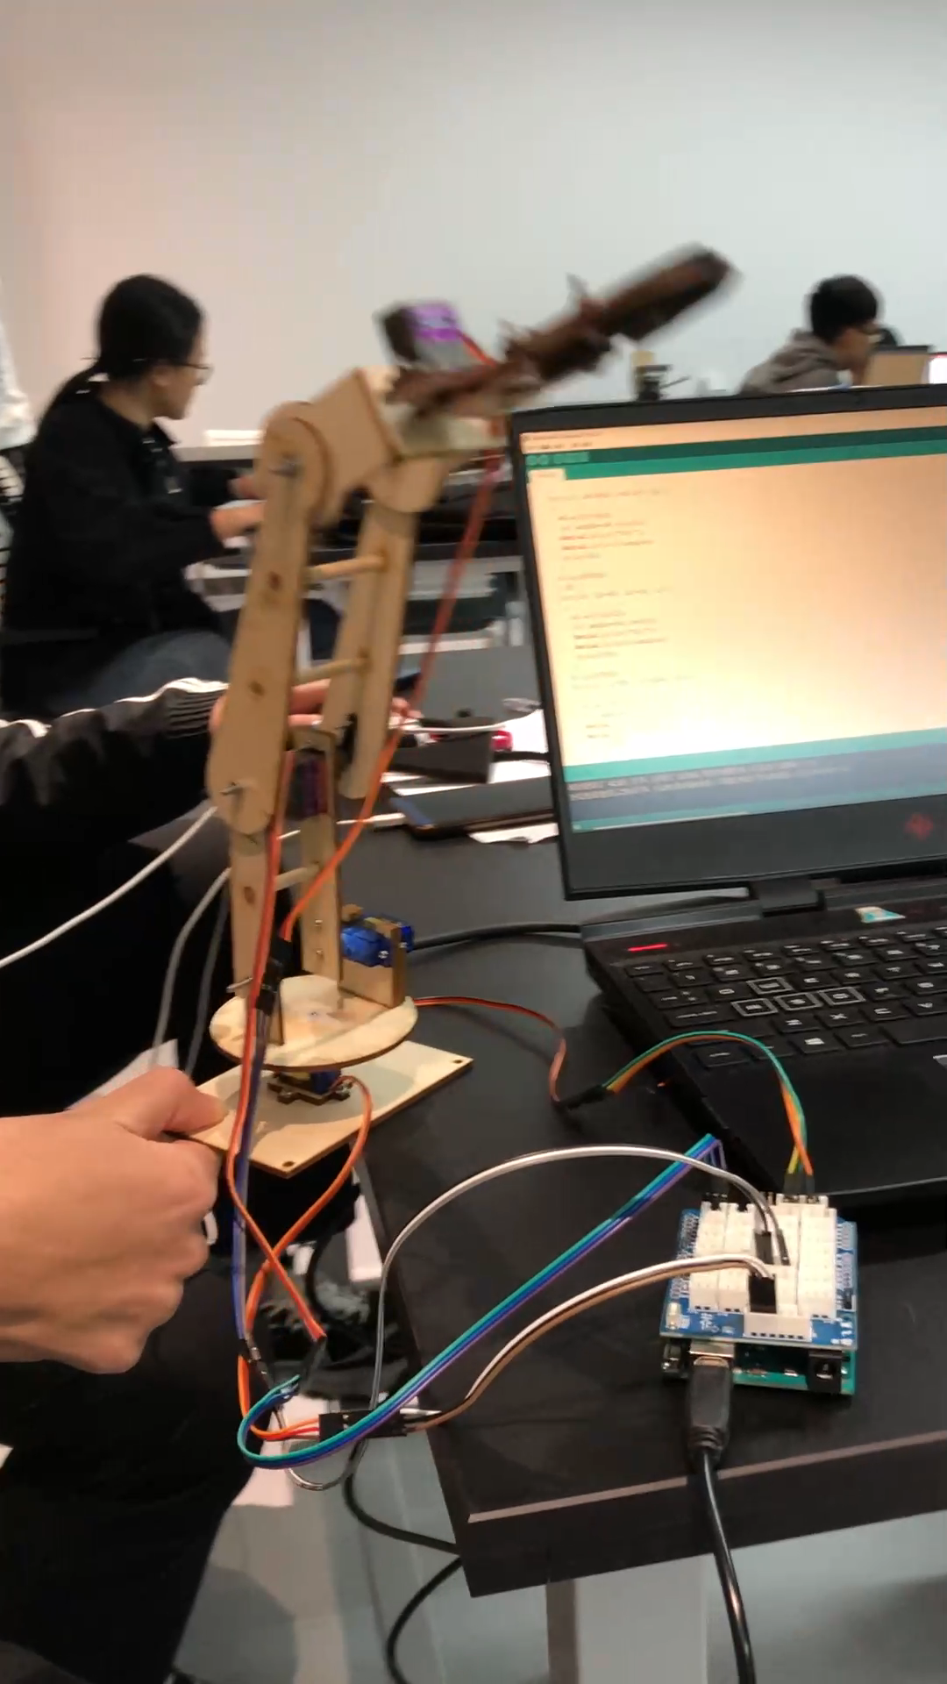
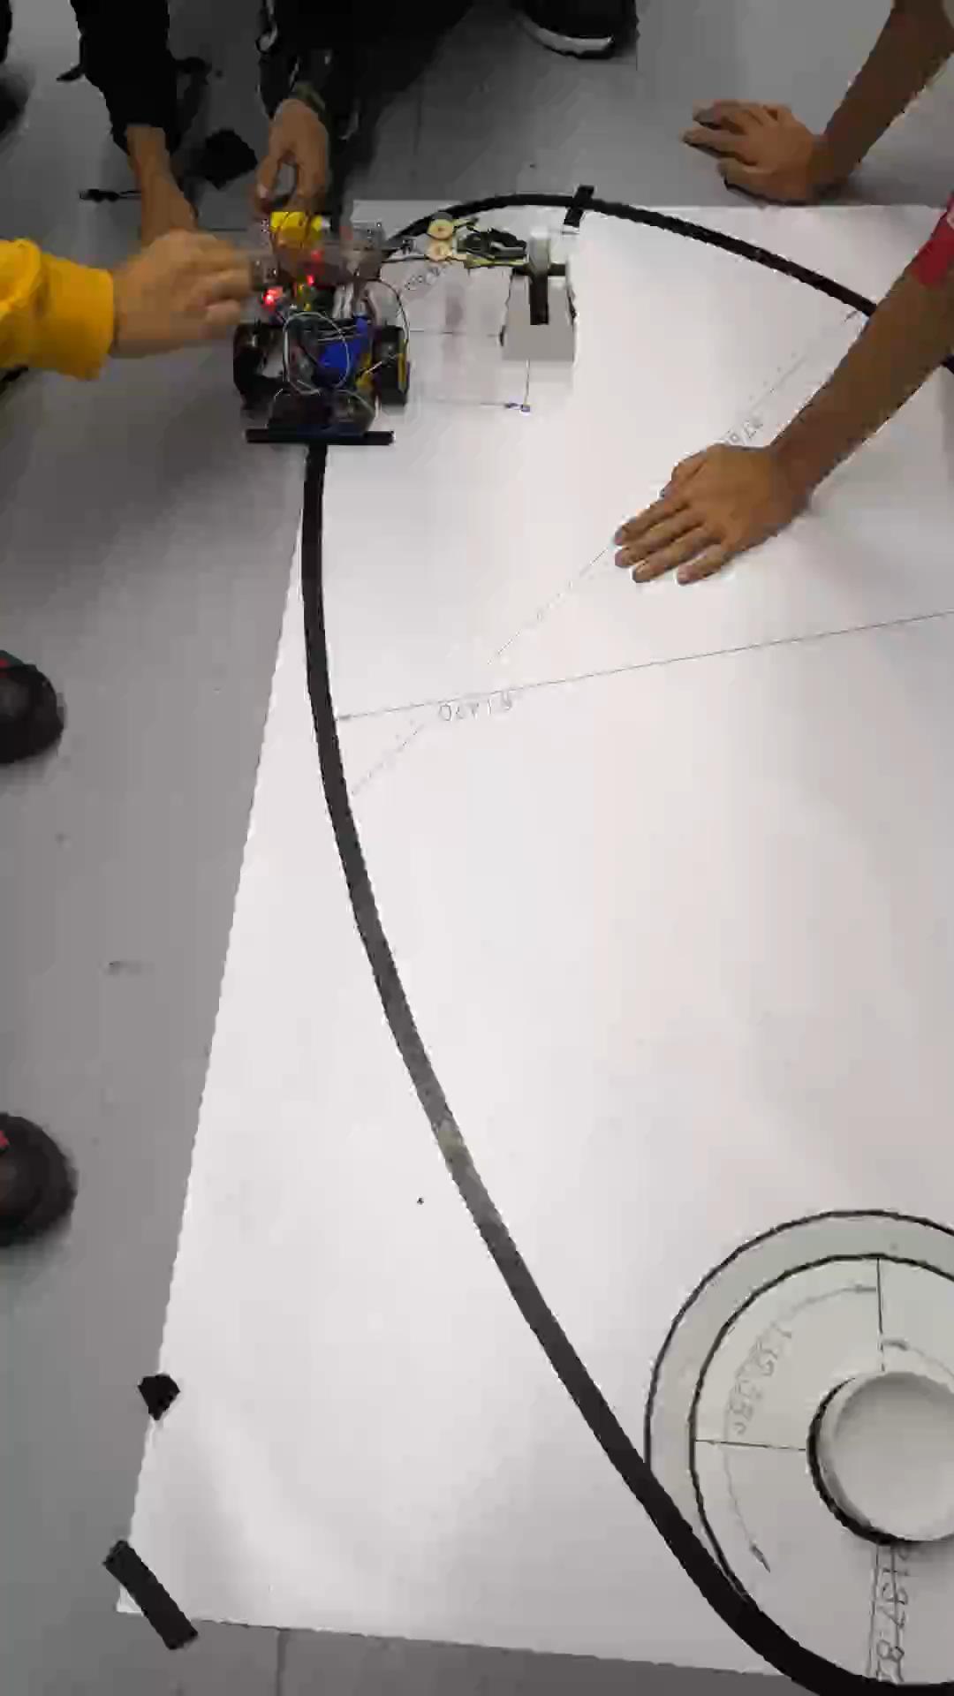
The Grippers
Grabbing the objects

Slide 15
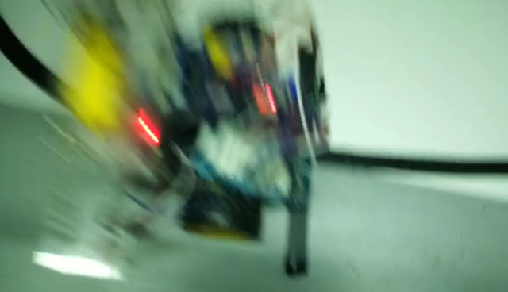
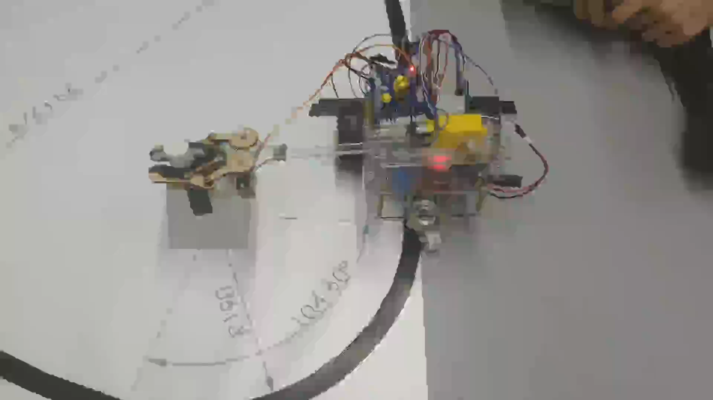
How they combine
Follow the tape and grab the object

Slide 16
4
Conclusion

Slide 17
Words from our hearts
Throughout the Vg Project
For failures and heartbreaking incidents:
We are grateful, for you awoke us and pointed out our flaws.
For all of the instructors and classmates who helped:
We wish you all the best, for you are family to us in this project.
For my brothers in the team:
We would keep making the impossible, for the cars and our friendships are the best treasures we gained and motivate us along the way.

Slide 18
Q & A

Slide 19
THANK YOU

